Slide 1
Optical Fiber Communication

Slide 2
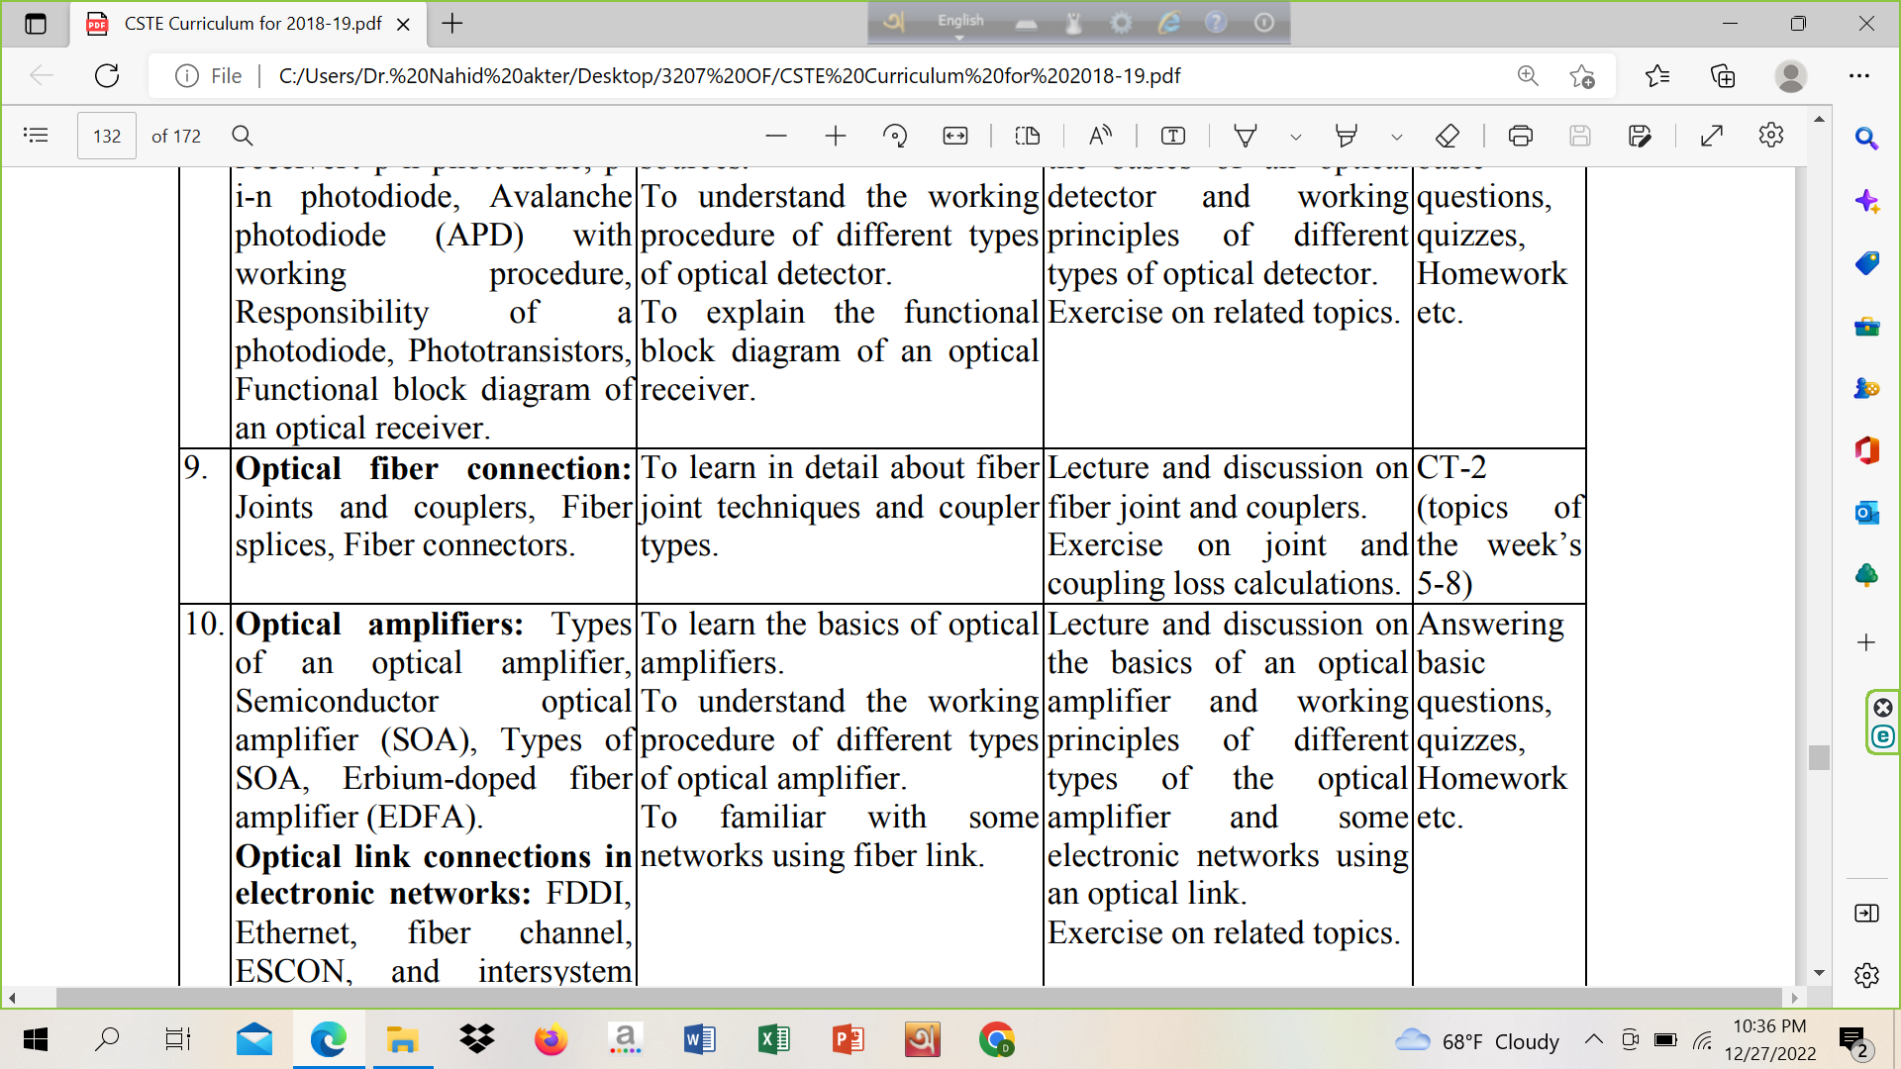
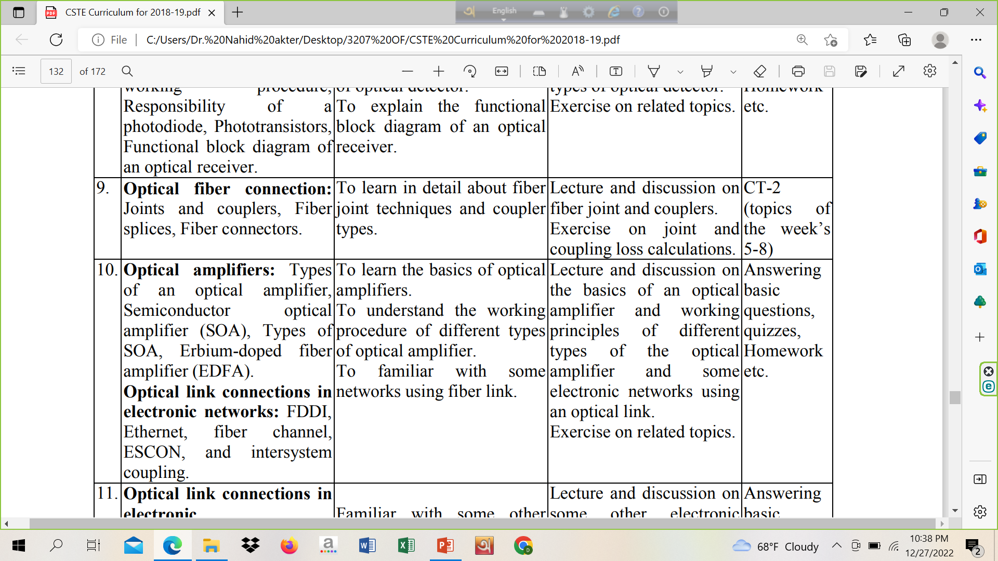

Slide 3
Optical Detectors

Slide 4
Phototransistor

Slide 5
Phototransistor (Detector)
A Phototransistor is an electronic switching and current amplification component which relies on exposure to light to operate. When light falls on the junction, reverse current flows which is proportional to the luminance. Phototransistors are used extensively to detect light pulses and convert them into digital electrical signals. These are operated by light rather than electric current. Providing large amount of gain, low cost and these phototransistors might be used in numerous applications.

Slide 6
Phototransistor
It is capable of converting light energy into electric energy. Phototransistors work in a similar way to photoresistors commonly known as LDR (light dependant resistor) but are able to produce both current and voltage while photoresistors are only capable of producing current due to change in resistance.
Phototransistors are transistors with the base terminal exposed. Instead of sending current into the base, the photons from striking light activate the transistor. This is because a phototransistor is made of a bipolar semiconductor and focuses the energy that is passed through it. These are activated by light particles and are used in virtually all electronic devices that depend on light in some way.
All silicon photo sensors (phototransistors) respond to the entire visible radiation range as well as to infrared.

Slide 7
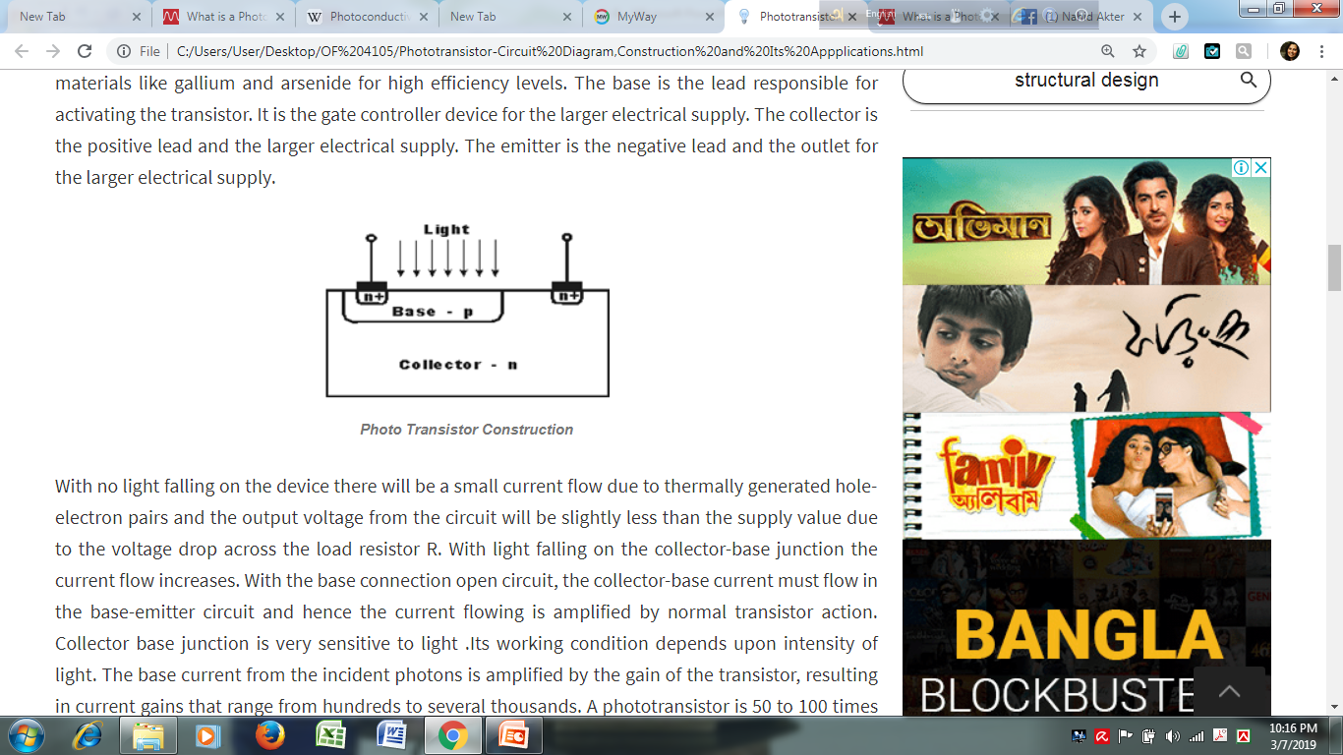
Phototransistor

Slide 8
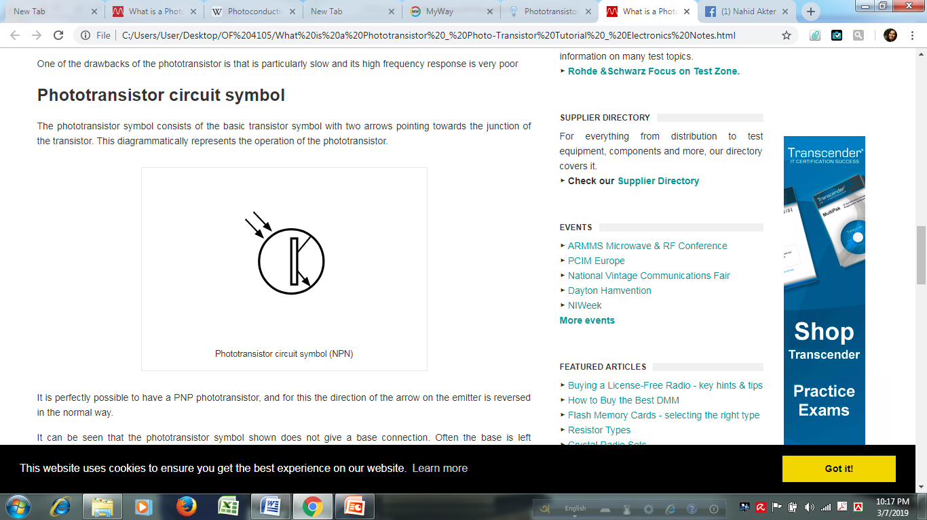
Symbol of Phototransistor

Slide 9
Home work Photodiode vs Phototransistor vs Photoresistor
https://www.youtube.com/watch?v=DNAgJrnj4EM
https://www.youtube.com/watch?v=YbQJq0o3J0k

Slide 10
Optical Fiber Connection

Slide 11
Joints and couplers
Fiber splices
Fiber connector

Slide 12
Fiber Joints
Unlike a normal wire joint there are some special joints for fiber optics which are classified below:
1: Splice: (i) Mechanical (ii) Fusion splice
2. Connector: (i) DNP (ii) SMA connector
3. Coupler: (i) T coupler (ii) Star coupler (iii) Three port coupler etc.

Slide 13
Splice
A permanent or semi permanent connection between two individual optical fibers is known as fiber splice. And the process of joining two fibers is called as splicing. Splices offer lower attenuation and lower back reflection than connectors and are less expensive.
Mechanical Splice/ V Groov – These are the joints that mechanically hold the two fiber ends and are just an alignment device enabling light to pass from one end to the other.

Slide 14
Splice
Mechanical Splice/ V Groov –
Mechanical splices join two fibers together by clamping them with a structure. Mechanical splices may have a slightly higher loss and back reflection. These can be reduced by inserting index matching gel. V groove mechanical splicing provides a temporary joint i.e fibers can be disassembled if required. The fiber ends are butted together in a V – shaped groove as shown in figure.

Slide 15
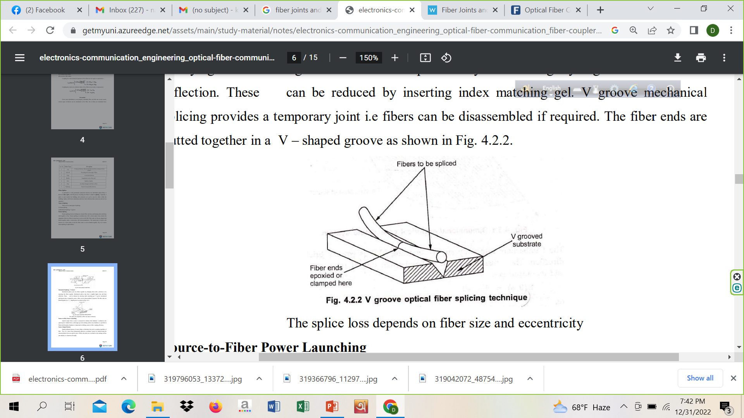
Splice

Slide 16
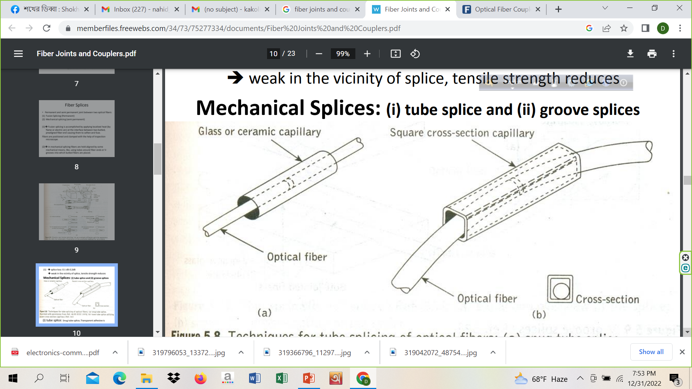
Splice

Slide 17
Splice
(ii) Fusion Splice
Fusion splicing involves butting two cleaned fiber end faces and heating them until they melt together or fuse. Fusion splicing is normally done with a fusion splicer that controls the alignment of the two fibers to keep losses as low as 0.05 dB. Fiber ends are first pre aligned and butted together under a microscope with micromanipulators. The butted joint is heated with electric arc or laser pulse to melt the fiber ends so can be bonded together.
It is a process in which two fiber ends are fused together using an electric arc. Generally monochromatic light is passed through one fiber end (input) and the other fiber end is adjusted in such a way that the output signal is maximum. At this point, high voltage is passed in an electric arc causing fusion of the two fiber ends.

Slide 18
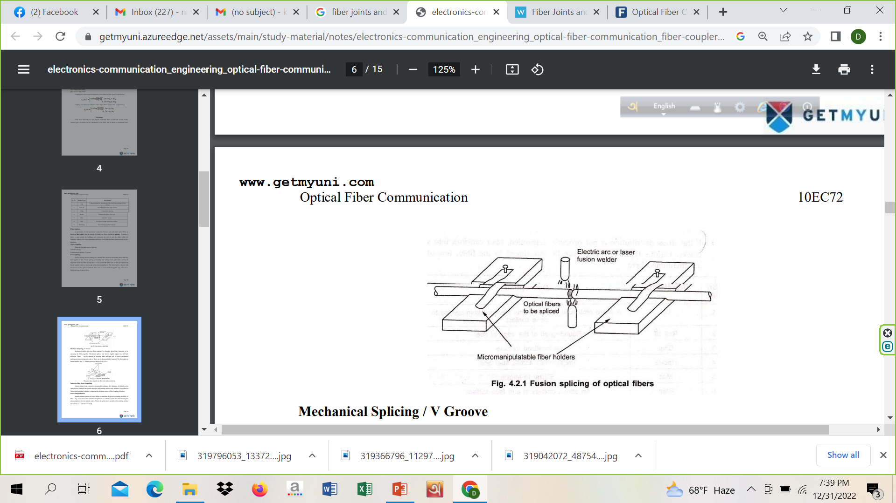
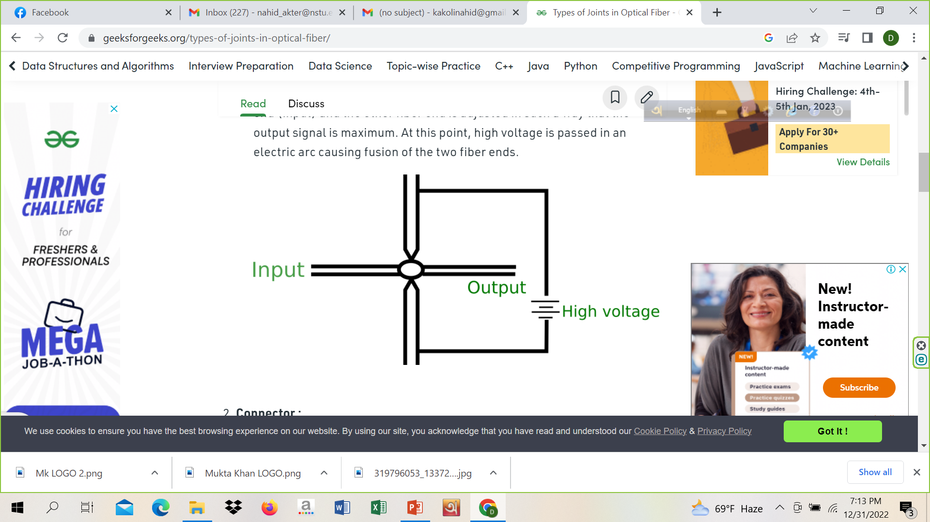
Splice

Slide 19
Connector
It is a joint which is temporary i.e. it is reusable. Some types of connector are:
DNP connector – Dry No Polish connector.
SMA connector – Surface Mount Adapter Connector.

Slide 20
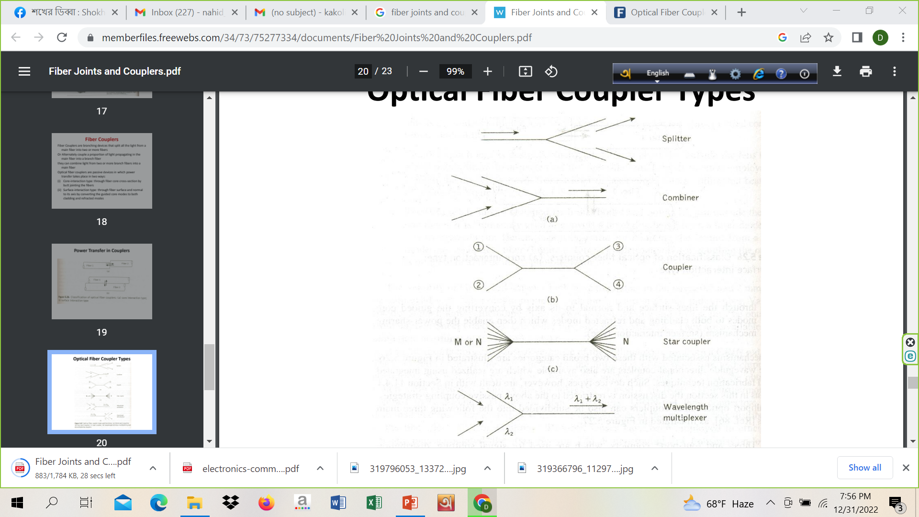
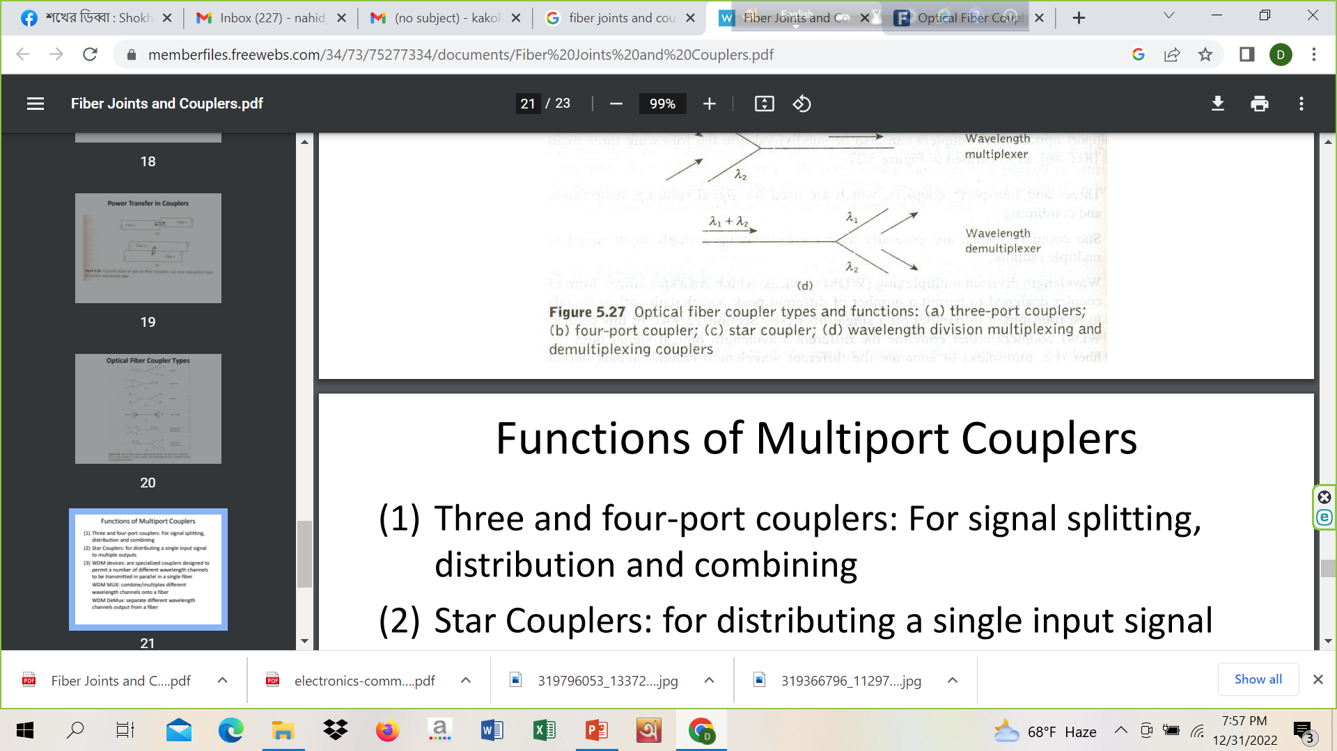
Coupler

Slide 21
Coupler
1. Y Coupler
Y coupler is also called tap coupler. This type of coupler simply divides the signal into two outputs. The power distribution ratio between two outputs can be precisely controlled, such as 10/90 percent, 20/80 percent, 30/70 percent, 40/60 percent or 50/50 percent.
2. T Coupler
T coupler functions the same as Y coupler. T couplers can be cascade to connect multiple terminals on a network, as shown below. The split ratio between two outputs should be 10/90 percent or 20/80 percent in order to have enough power left for next terminal in the link.
Advantages of T and Y Coupler
T couplers are readily available and can be terminated with standard connectors such as SC, ST, FC, LC, etc. You can quickly set up a small network with T couplers cascaded that way.

Slide 22
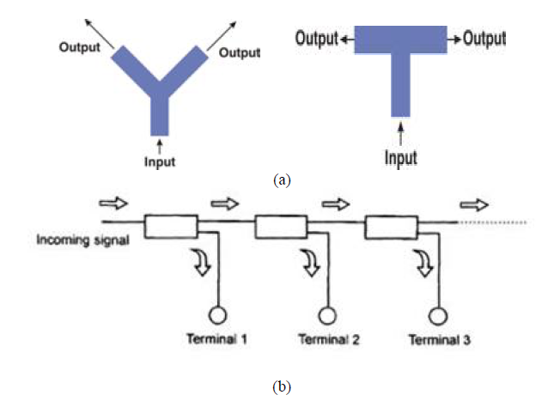

Slide 23
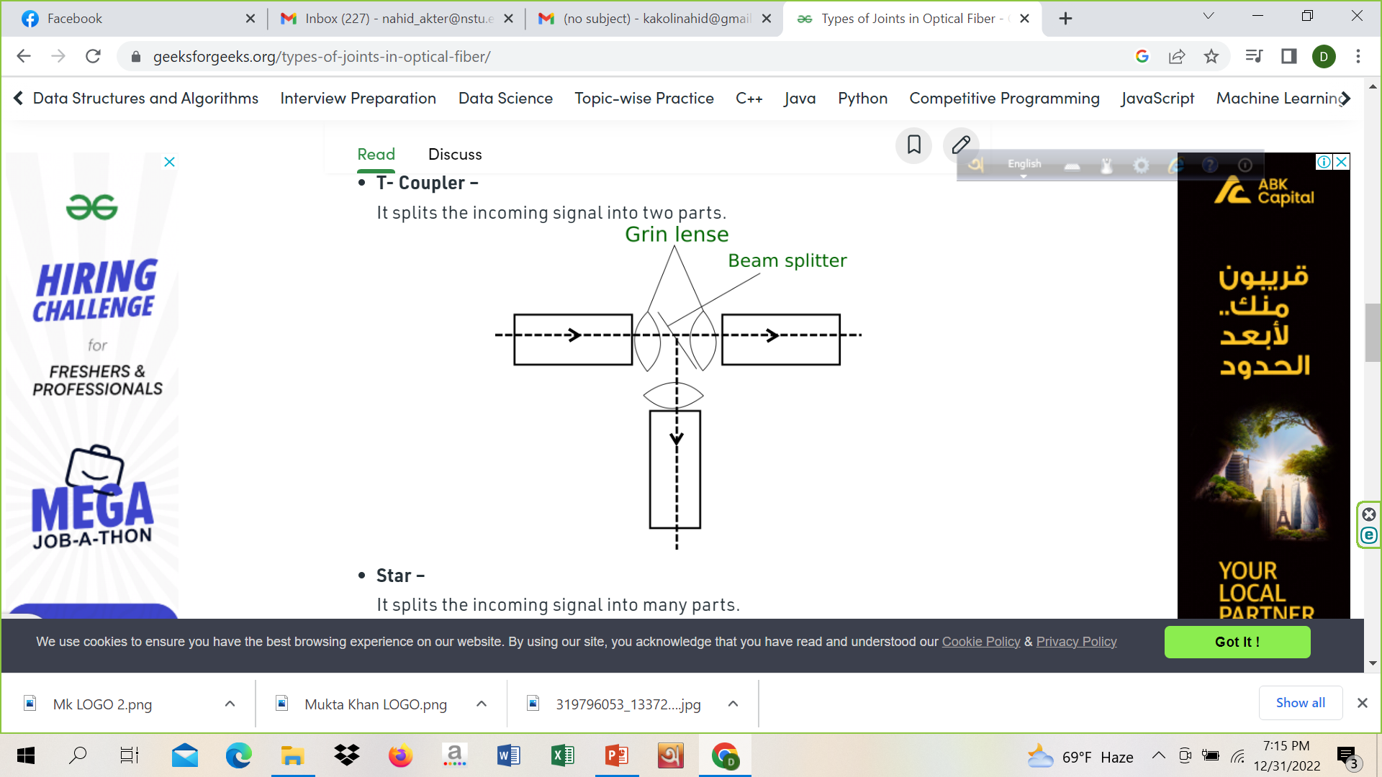
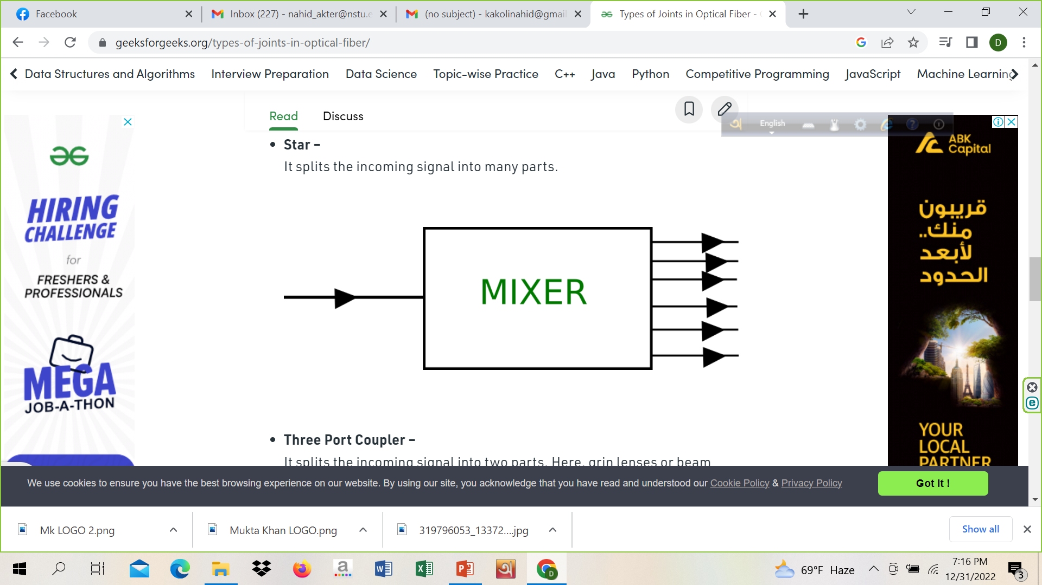
T and Star Coupler
It is a device that is used for multiplexing and de-multiplexing a signal. When a coupler is used for de-multiplexing a signal it is known as a Combiner. There are many types of coupler such as :T- Coupler – It splits the incoming signal into two parts
Star – It splits the incoming signal into many parts.

Slide 24
Coupler
3. Star Couplers
Star couplers have multiple inputs and outputs. The input and output port number could be the same or not, such as 2×2, 4×4, 8×8, etc. Star couplers distribute the input power uniformly among the output fibers.
A) Directional Star Coupler
The first type is directional, mixing optical signals from all inputs and then distribute them among all outputs. These are bidirectional devices because they also can transmit light in the opposite direction.
Note: an optical signal introduced into any input port is distributed to all output ports.

Slide 25
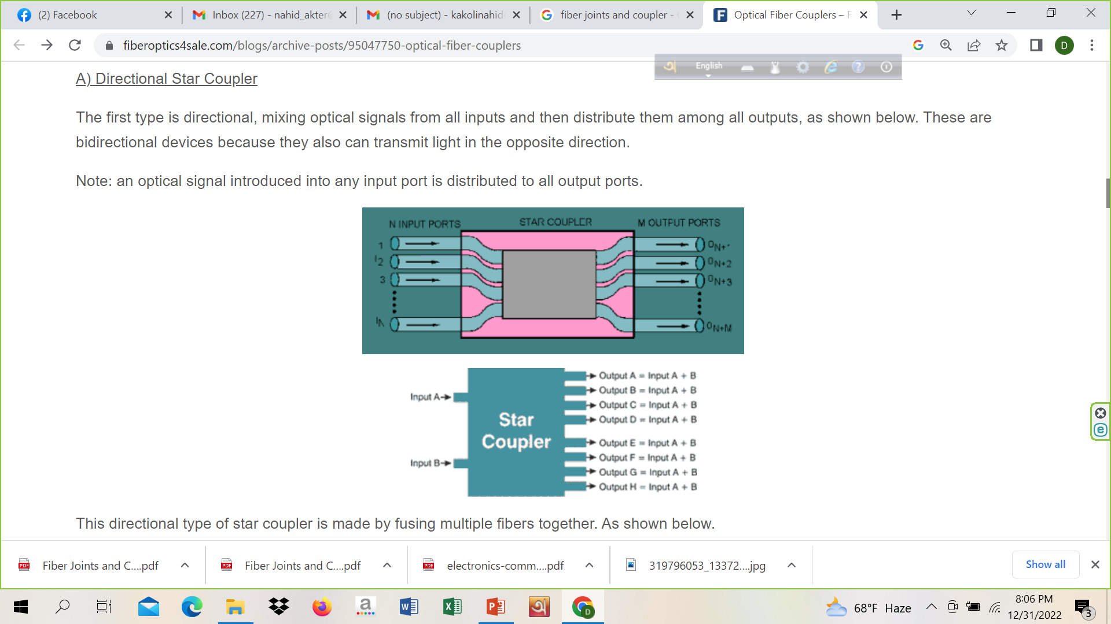
Coupler

Slide 26
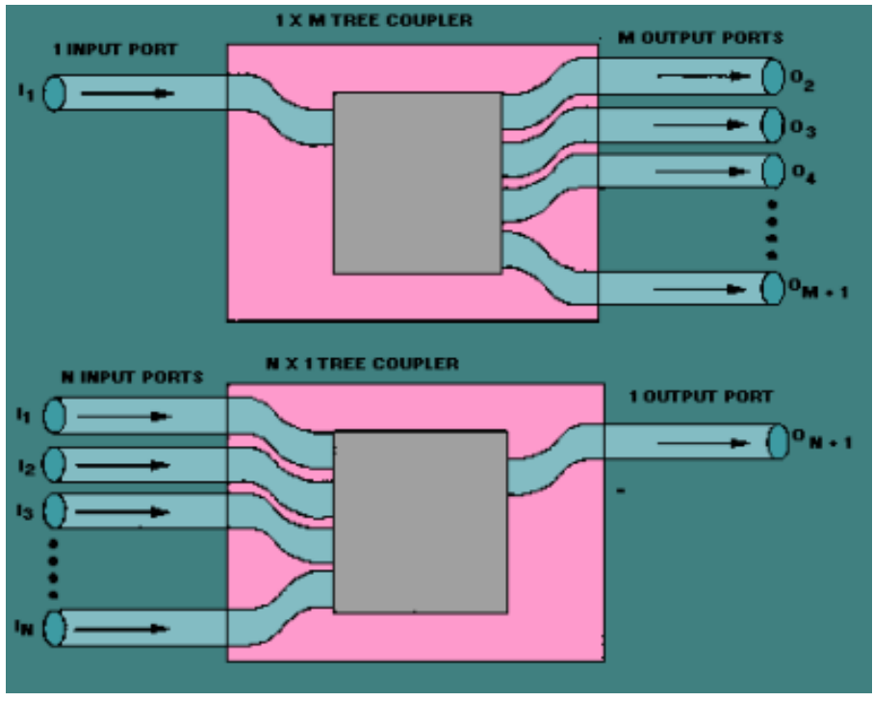
Splitter and Combiner

Slide 27
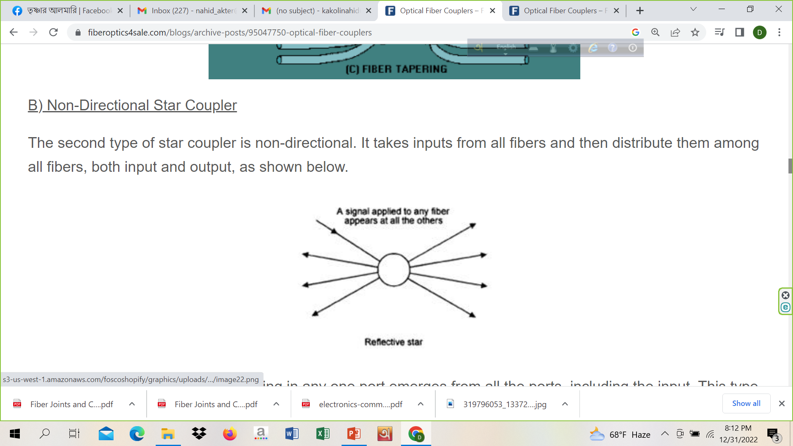
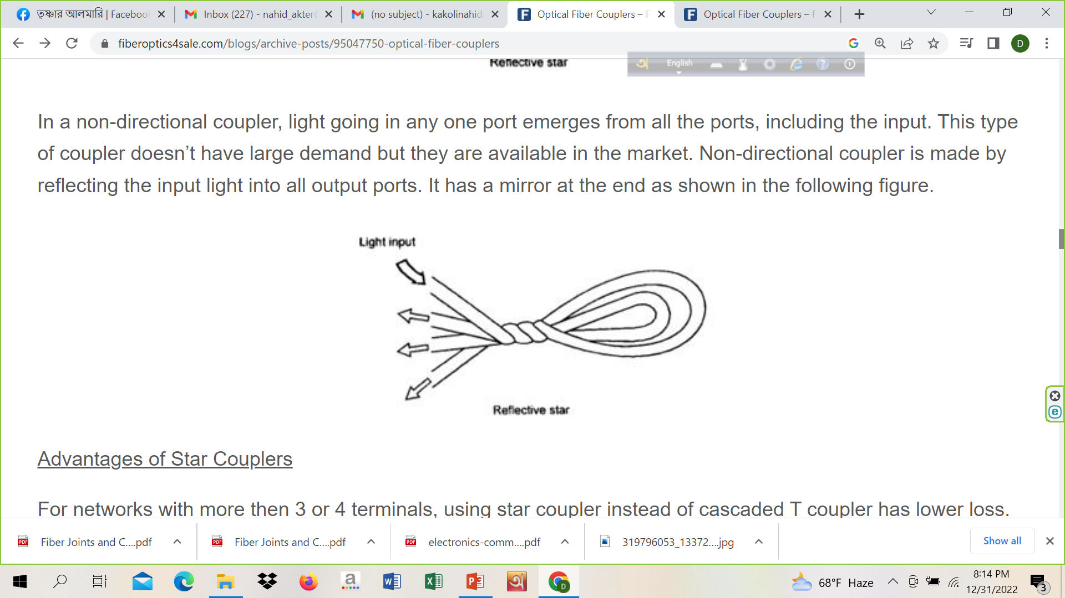
Coupler
B) Non-Directional Star Coupler
The second type of star coupler is non-directional. It takes inputs from all fibers and then distribute them among all fibers, both input and output.
In a non-directional coupler, light going in any one port emerges from all the ports, including the input. This type of coupler doesn’t have large demand but they are available in the market. Non-directional coupler is made by reflecting the input light into all output ports. It has a mirror at the end.

Slide 28
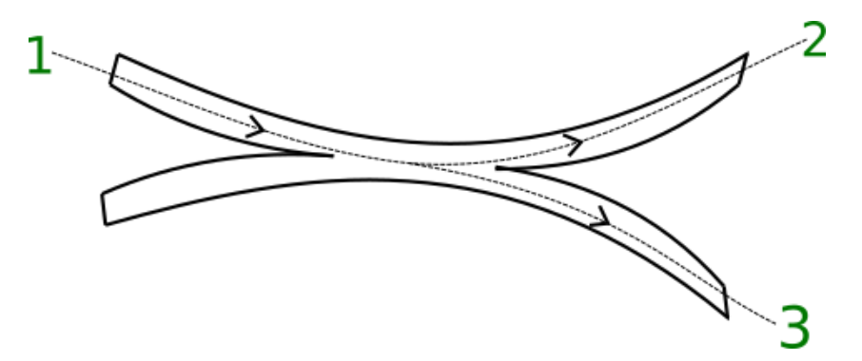
Coupler
Three Port Coupler – It splits the incoming signal into two parts. Here, grin lenses or beam splitter is not used.

Slide 29
Fiber Splices (Ref Videos)
https://www.youtube.com/watch?v=l9mJZnxjNPo
https://www.youtube.com/watch?v=6ZG9gwfiDT4

Slide 31
Optical Amplifiers

Slide 32
Optical Amplifier
If the signal attenuation is 0.2 dB/km , and the fiber length is 100 km then the signal attenuation becomes 20 dB.
**Amplifier: O/E (optical to electronic domain), cleaned, amplify, then retransmitted in the optical domain.
Optical amplifiers amplify the signal in optical domain. No need to convert the signal into electronic signal.

Slide 33
Classification
EDFA
Raman amplifier
SOA
These amplifiers are based on the phenomenon of stimulated emission.

Slide 34
EDFA

Slide 35
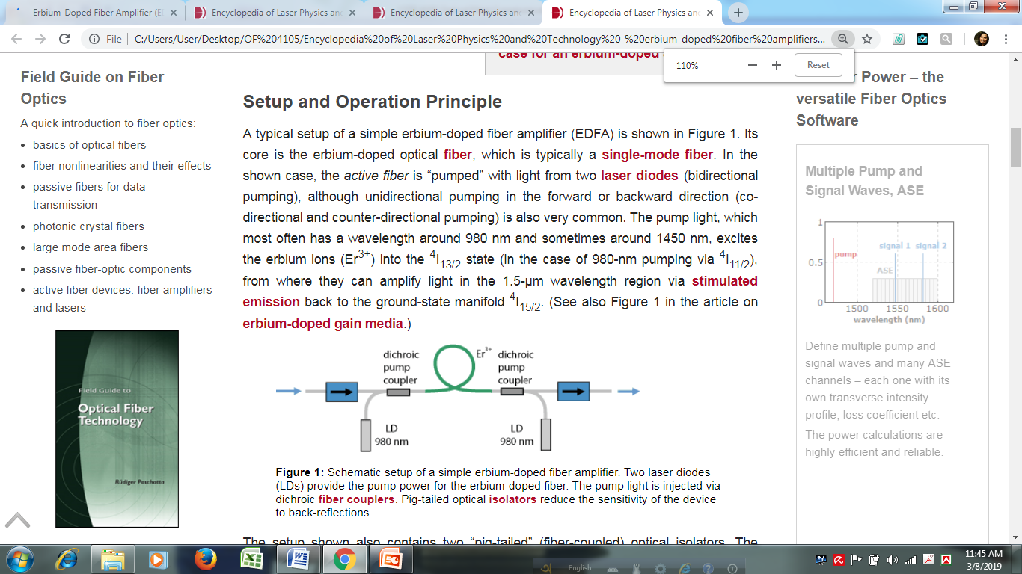
Setup and Operation Principle
EDFA
Wavelength selection coupler
Isolator
Signal input 1530 nm
Signal output
Pump source
Residual pump

Slide 36
Setup and Operation Principle
When silica glass is doped with erbium ions then erbium ions splits into discrete energy levels. Er³⁺ means three energy levels E1, E2, E3. These process is called stark splitting. Electrons are those energy bands exists non uniform way called thermalization. When the pump energy is 980 nm it has higher energy according to the formula E=hC/λ, so that it can easily carry the electron from E1 to E3. Electron drops from E3 to E2 by spontaneous emission by 1 μs. And the times taken from E2 to E1 is 10 ms. As more times the electrons are stay in E2, the concentration of electrons (N2) larger than N1 (N2>N1). That’s why population inversion occurs. When population inversion occurs it release the energy of 1530 nm. And the signal will be amplified.
Isolator is used to reduce the back reflection. Residual pump used to separate the signals.

Slide 37
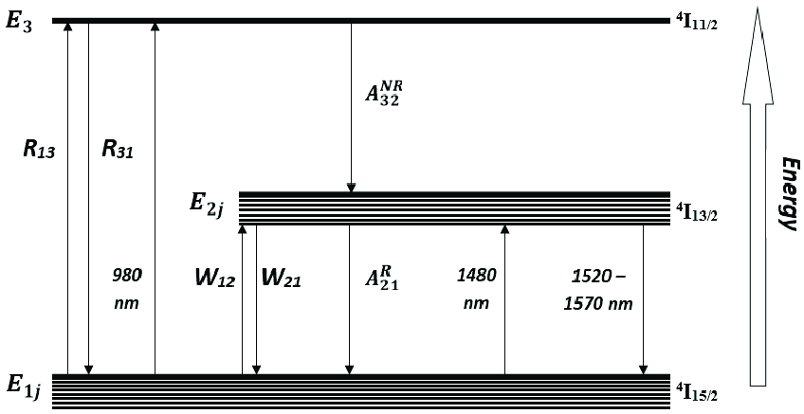

Slide 38
Semiconductor Optical Amplifier (SOA)
A semiconductor optical amplifier is an optical amplifier based on a semiconductor gain medium. It is essentially like a laser diode where the end mirrors have been replaced with anti-reflection coatings; a tilted waveguide can be used to further reduce the end reflectivities.
The input signal light is usually sent through a semiconductor single-mode waveguide with transverse dimensions of e.g. 1–2 μm and a length of the order of 0.5–2 mm. The waveguide mode (signal light) has significant overlap with the active (amplifying) region, which is pumped with an electric current. The injection current creates a certain carrier density in the conduction band (by excitation electrons), allowing for optical transitions from the conduction band to the valence band. The maximum gain occurs for photon energies slightly above the bandgap energy.

Slide 39
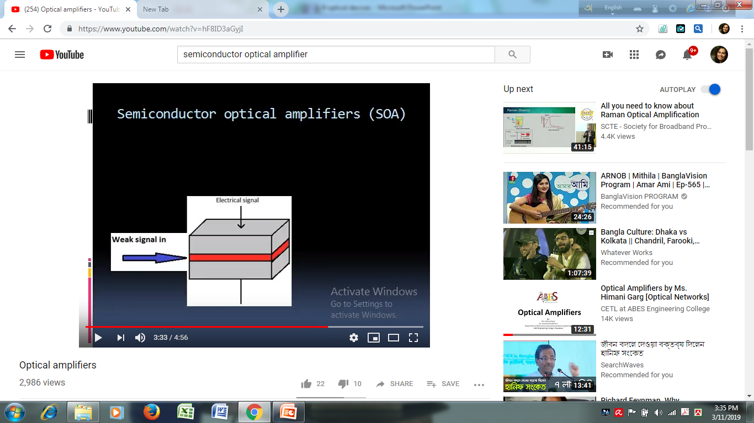
SOA

Slide 40
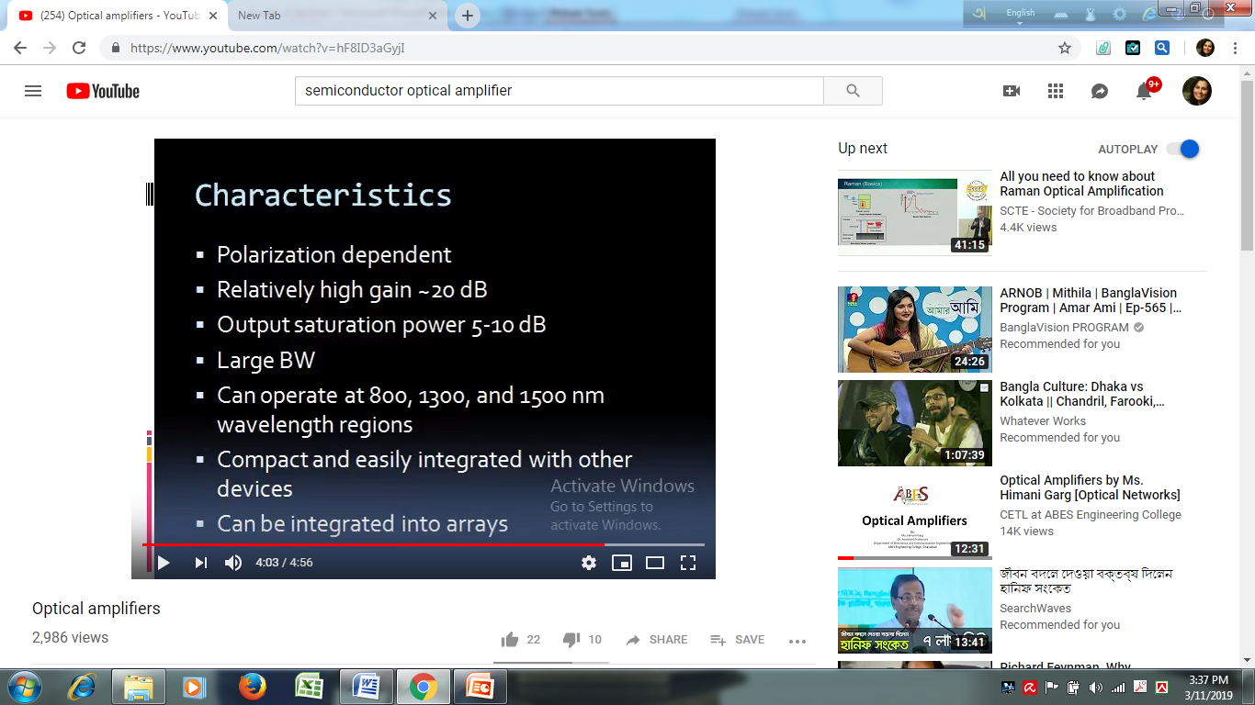
SOA Features

Slide 41
Home work
Comparison between EDFA and SOA

Slide 42
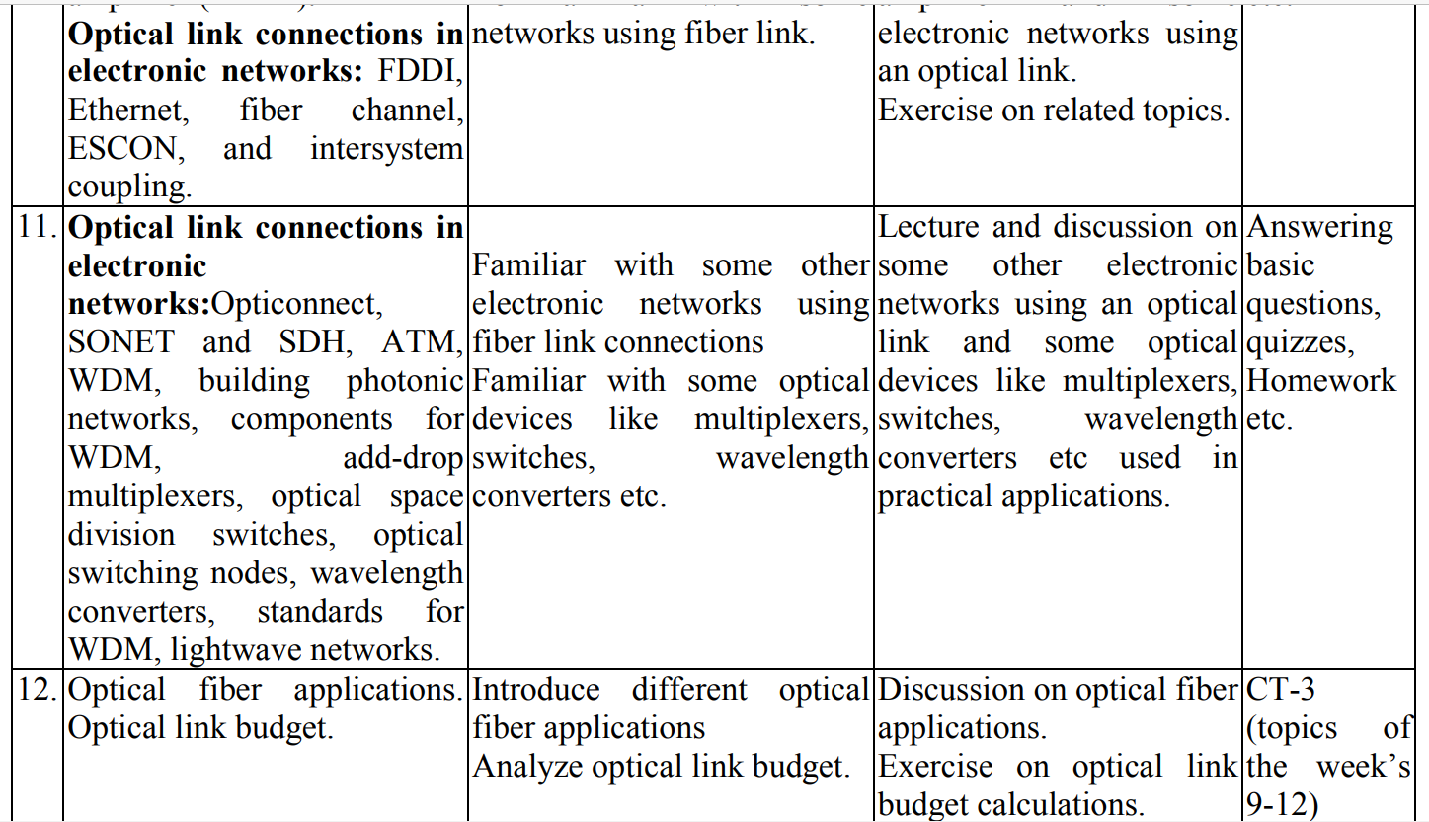

Slide 43
Optical Link Connections in Electronic Networks

Slide 44
FDDI Fiber Distributed Data Interface
https://www.tutorialspoint.com/fiber-distributed-data-interface-fddi#:~:text=The%20fields%20of%20an%20FDDI,specifies%20address%20of%20destination%20station.

Slide 45
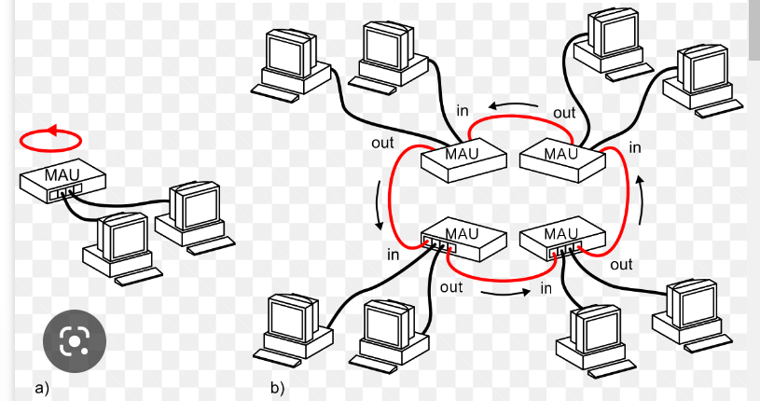

Slide 46
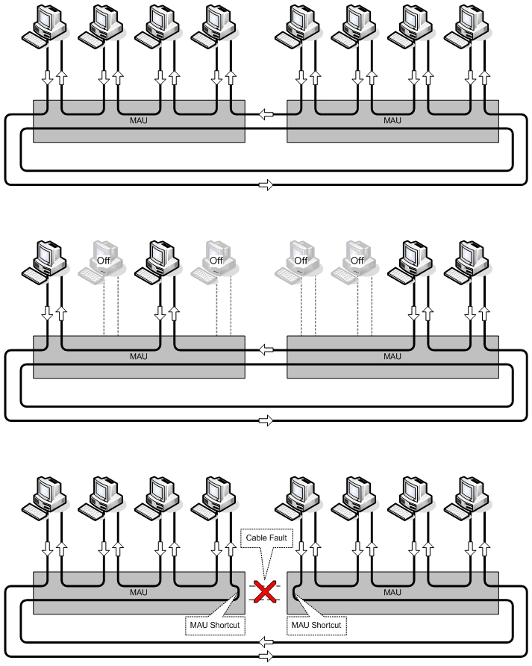

Slide 47
FDDI Network Protocol (see ref pdf)

Slide 48
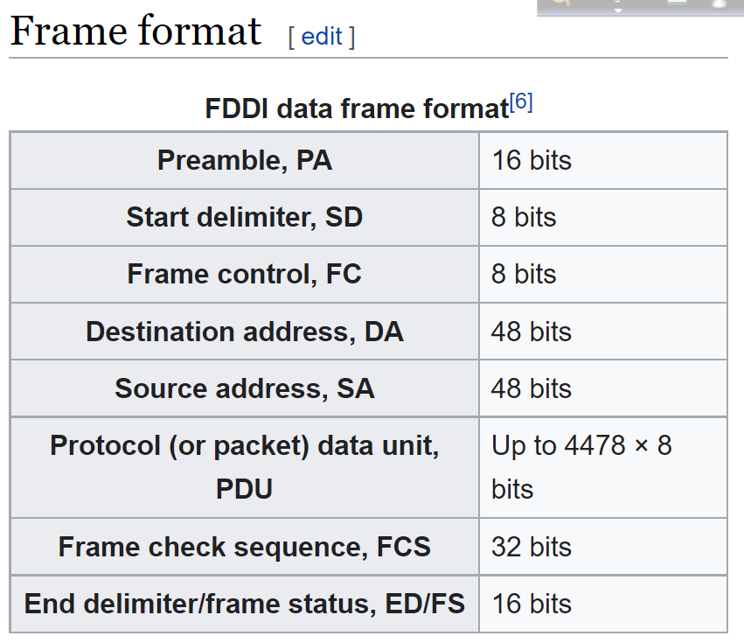
FDDI Frame Format

Slide 49
ATM Asynchronous Transfer Mode

Slide 50
ATM UNI/NNI Cell Format (see ref pdf)

Slide 51
WDM Wavelength Division Multiplexing

Slide 52
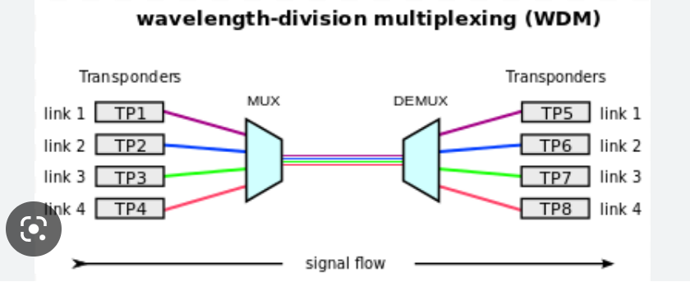
WDM System

Slide 53
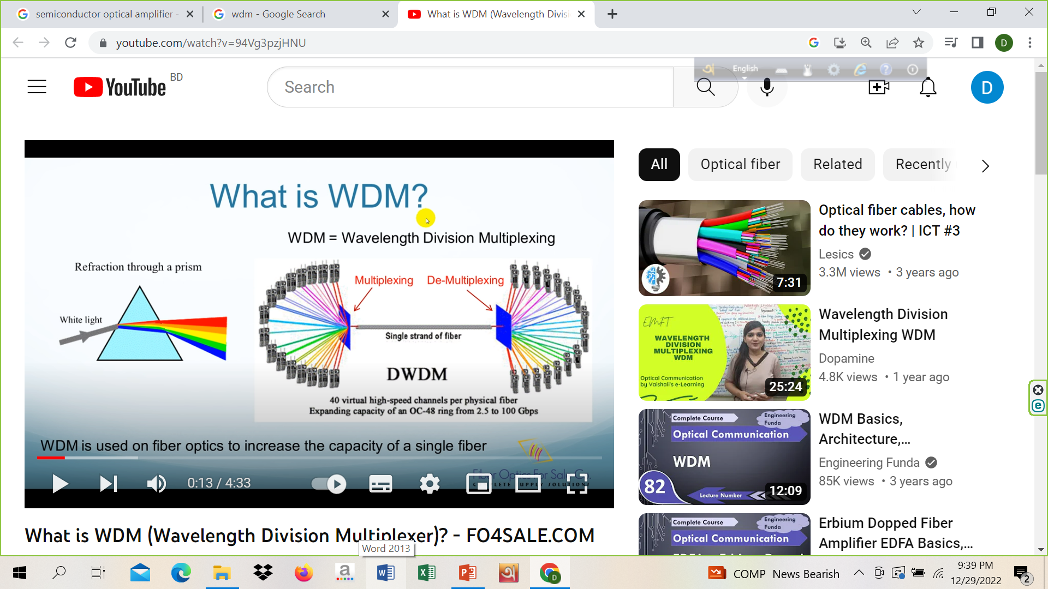
WDM System

Slide 54
Concept and Process of WDM
In WDM, the optical signals from different sources or (transponders) are combined by a multiplexer, which is essentially an optical combiner. They are combined so that their wavelengths are different.
The combined signal is transmitted via a single optical fiber strand. At the receiving end, a demultiplexer splits the incoming beam into its components and each of the beams is send to the corresponding receivers.
Example
The following diagram conceptually represents multiplexing using WDM. It has 4 optical signals having 4 different wavelengths. Each of the four senders generates data streams of a particular wavelength. The optical combiner multiplexes the signals and transmits them over a single long-haul fiber channel. At the receiving end, the splitter demultiplexes the signal into the original 4 data streams.

Slide 55
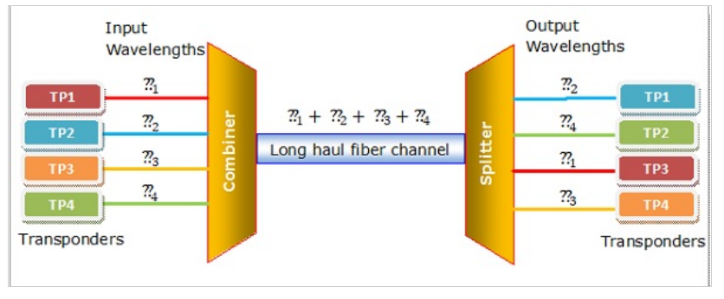

Slide 56
Categories of WDM
Based upon the wavelength, WDM can be divided into two categories:
Course WDM (CWDM) : CWDM generally operates with 8 channels where the spacing between the channels is 20 nm (nanometers) apart. It consumes less energy than DWDM and is less expensive. However, the capacity of the links, as well as the distance supported, is lesser.
Dense WDM (DWDM) : In DWDM, the number of multiplexed channels much larger than CWDM. It is either 40 at 100GHz spacing or 80 with 50GHz spacing. Due to this, they can transmit the huge quantity of data through a single fiber link. DWDM is generally applied in core networks of telecommunications and cable networks. It is also used in cloud data centers.

Slide 57
Fiber Optic Link Budget Calculation

Slide 58
Basic elements influence the fiber optic system link budget:
Fiber loss factor
Types of fiber
Transmitter
Receiver sensitivity
Number/type of splices, connectors
Margin (3-10 dB)

Slide 59
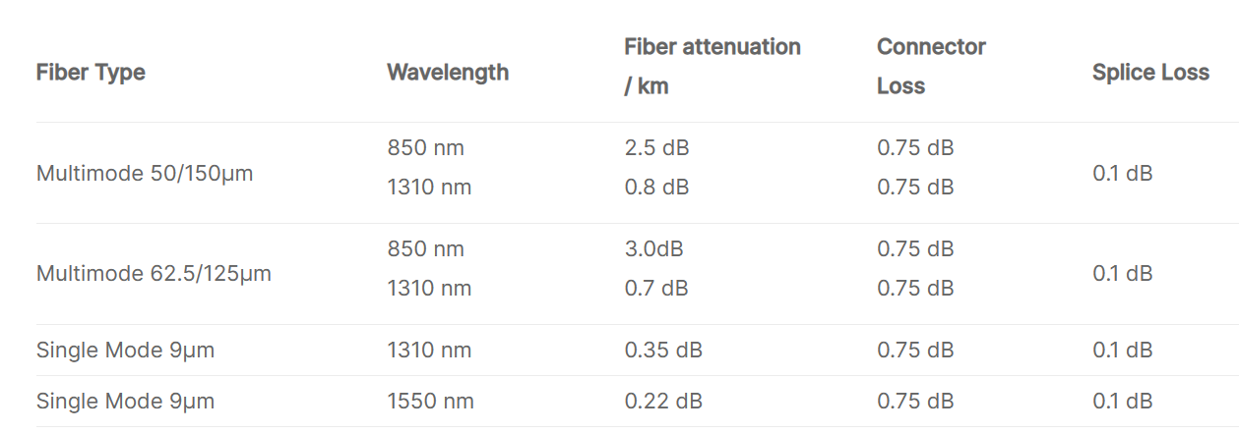
Commonly accepted loss values for the link budget calculation

Slide 60
Link budget (loss) calculation
Link Budget = [fiber length (km) × fiber attenuation per km] + [splice loss × no. of splices]+[connector loss × no. of connectors] + [safety margin]
For example: Assume a 10 km single mode fiber link at 1310nm with 2 connector pairs and 2 splices.
Answer: Link Budget= [10km × 0.35dB/km] + [0.1dB × 2] + [0.75dB × 2] + [3.0dB] = 8.2dB

